Slide 1
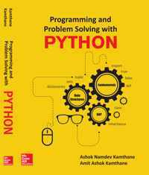
Programming and problem solving with python
Chapter 10
Object Oriented Programming : Class, Objects and Inheritance
Copyright © 2018 McGraw Hill Education, All Rights Reserved.
PROPRIETARY MATERIAL © 2018 The McGraw Hill Education, Inc. All rights reserved. No part of this PowerPoint slide may be displayed, reproduced or distributed in any form or by any means, without the prior written permission of the publisher, or used beyond the limited distribution to teachers and educators permitted by McGraw Hill for their individual course preparation. If you are a student using this PowerPoint slide, you are using it without permission.

Slide 2
Introduction
Python is an object oriented language.
Object oriented languages helps programmer to reduce complexity of programs
The general concept of object oriented programming language is about class.
The class is just another name for a type in python.
Where as Objects are instances of a class
An object is a container of data: attributes
An object has associated functions: methods

Slide 3
Defining Classes
The class is just another name for type in python.
The class may contain data in the form of fields.
Fields are also called as attributes and code in the form of procedure known as methods.
The Syntax for defining Class is as follows
Class Class_Name: Initializer attributes methods() statements

Slide 4
A simple class program
Write a simple class program and print the message “Welcome to Classes”.
class MyFirstClassProgram: print(' Welcome to Classes') C=MyFirstClassProgram() #Instance of class. print(C) Output: Welcome to Classes <__main__.MyFirstClassProgram object at 0x00000000067BF908>

Slide 5
Adding, Assigning and Accessing values to an Attributes
Adding attribute to the class
The syntax to add attribute to the class is as follows
class class_name:
attribute_name = value
…………………………………………………………
…………………………………………………………
Accessing attributes of a class
The following syntax is used to access attributes of a class
<object>.<attribute>
Assigning values to an attributes outside the class
<object>.attribute = Value

Slide 6
Example:
class Rectangle: length=0; #Attribute length breadth=0; #Attribute breadth R1 = Rectangle () #Instance of a class print('Initial values of Attribute') print('Length = ',R1.length) #Access attribute length print('Breadth = ',R1.breadth) #Access attribute breadth print('Area of Rectangle = ',R1.length * R1.breadth ) R1.length = 20 #Assign value to attribute length R1.breadth = 30 #Assign value to attribute breadth print('After reassigning the value of attributes') print('Length = ',R1.length ) print('Breadth = ',R1.breadth ) print('Area of Rectangle is ',R1.length * R1.breadth) Output: Initial values of Attribute Length = 0 Breadth = 0 Area of Rectangle = 0 After reassigning the value of attributes Length = 20 Breadth = 30 Area of Rectangle is 600

Slide 7
Adding Methods to The Class
Class consist of two things i.e. instance variable and instance methods.
The syntax to add methods to the class is follows
Note:
The first parameter for each method should be self if method exist within the class.
The self parameter references the object itself.
class Class_Name: instance variable; #instance variable with initialization def mthod_name(Self,parameter_list):#Paramter List is Optional block_of_statements

Slide 8
Program:
Program to create method Display_Message() display message “Hello, Learn Adding Methods” within the methods.
class Demo: def Display_Message(self): print('Hello, Learn Adding Methods') D1 = Demo() D1.Display_Message()1 Output: 'Hello, Learn Adding Methods

Slide 9
The __init__ method (Constructor)
The __init__ method is known as an initializer.
It is a special method that is used to initialize instance variable of an object.
This method run as soon as an object of a class is instantiated.
The syntax of adding __init__ method to class is follows
Note:
a) __init__ method must have self as first argument.
b) As self refers to the object itself. Therefore it refers to the object that invokes the method.
class Class_Name: def _init_(self): #__init__ method ………………………… …………………………

Slide 10
Program
Write a program to calculate area of circle by making use of __init__ method.
class Circle: def __init__(self,pi): self.pi = pi def calc_area(self,radius): return self.pi*radius**2 C1=Circle(3.14) print(' The area of Circle is ',C1.calc_area(5)) Output: The area of Circle is 78.5

Slide 11
The __del__() (Destructor Method)
The method __del__ denotes the destructor
Following is the syntax to define destructor.
Syntax:
def __del__(self):
block
Python invokes destructor method when instance is about to be destroyed.
The self refers to the instance on which __del__() method invoked.

Slide 12
Inheritance
Inheritance is one of the most useful and essential characteristics of object-oriented programming.
The existing classes are main components of inheritance. The new classes are created from existing one.
The properties of existing classes are simply extended to the new classes.
The new classes created using such method are known as derived classes or sub class and the existing classes are known as base class or super class.

Slide 13
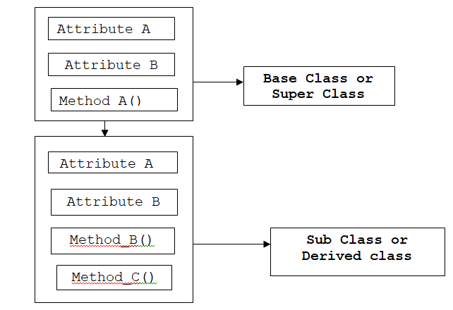
Example of Inheritance

Slide 14
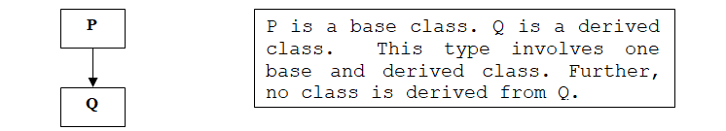
Type of Inheritance
Single Inheritance
Only one base class is used for derivation of a new class. Further, the derived class is not used as base class.
Syntax to inherit single Base class:
Class Derived_Class_Name(Single_Base_Class_Name): Body_of_Derived_Class

Slide 15
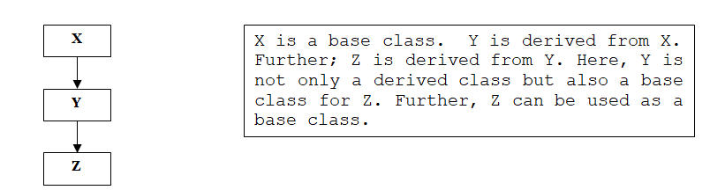
Inheritance continued…..
Multilevel Inheritance
When a class is derived from another derived class i.e. derived acts as base class. Such type of inheritance is known as Multilevel Inheritance.
Syntax:
Class Derived_Class_Name(Comma_Seperated_Base_Class_Names): Body_of_Derived_Class

Slide 16
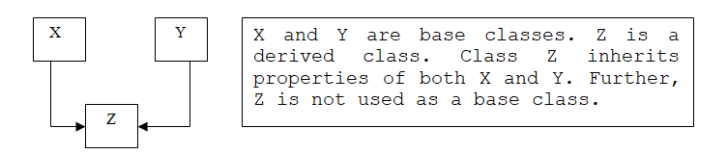
Inheritance continued…..
Multiple Inheritance
When two or more base classes are used for derivation of a new class is called multiple Inheritance.

Slide 17
Program: A simple example of Inheritance
class A: def Message1(self): print('I am in A') class B(A): def Message2(self): print('I am in B') D1 = B() D1.Message2() D1.Message1() Output: I am in B I am in A

Slide 18
Conclusion……
class and objects that reduces the complexity of programs.
Attributes and member function belongs to the class.
The self parameter is used to reference object itself
A programmer can initialize the value of member variable or attribute by making use of __init__ method.
Python also supports various types of inheritance such as single inheritance, multiple and multi level inheritance.

